Slide 1




CIM TGM 2024
-
Highlights
Consumption & Lifestyle Survey
8.000 Interviews
26 Survey Modules
1.200 Questions
10.000+ Answer Options

Slide 2
Leasure: Media is popular
Top 10 Activities: Media Leads, Food Follows, Friends, Relaxation, and Walking Complete the List
Watched TV at home
Done nothing/relaxed
Taken a walk
Browsed the internet
Gone shopping
Cooked meals
Visited friends or hosted them
Listened to music/podcasts/radio
Eaten out (not work-related)
Watched films or videos

Slide 3


Leasure: the biggest growers
Hobbies like gardening, painting, drawing, crafting, and sculpting are gaining popularity, with more people engaging in them at least once a month. This growth highlights a rising interest in creative, hands-on activities as people seek ways to unwind, express their creativity, and enjoy personalized experiences.
48% of Belgians garden at least 1x month
17% of Belgians paint, draw, sculpt or craft at least 1x month
+8%*
+10%*
* Relative percentages between TGM23 and 24

Slide 4
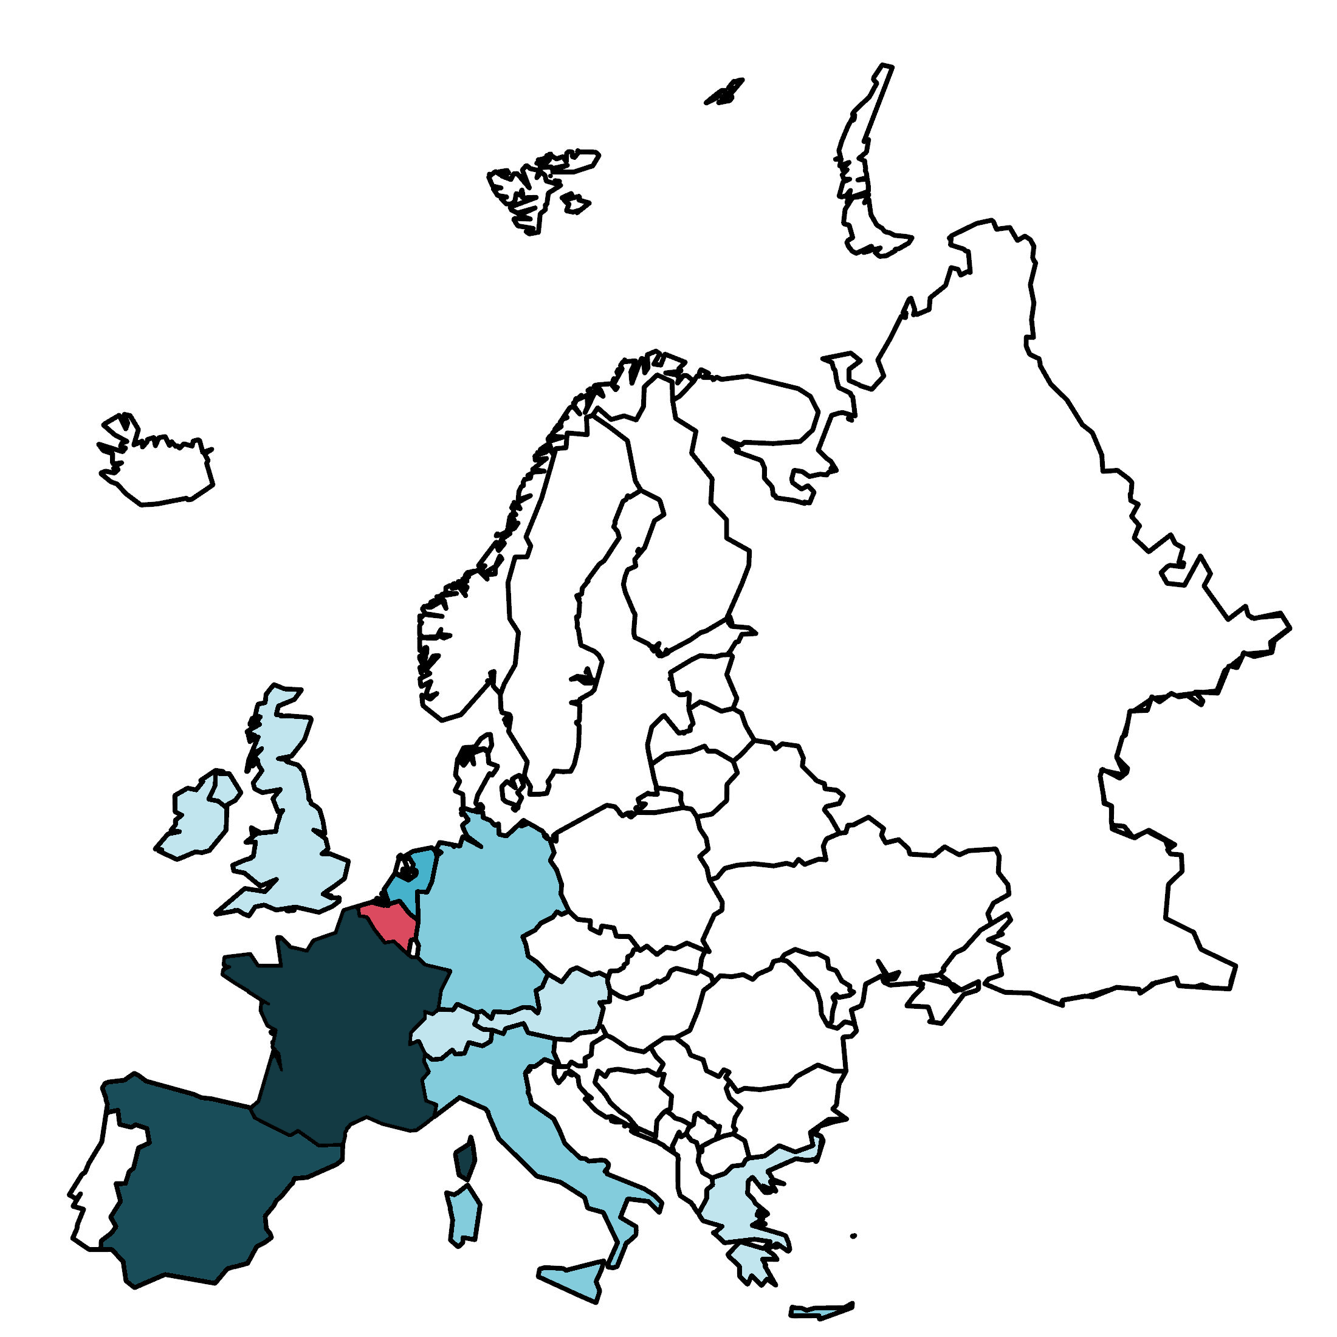
Holidays
Our favourite destinations remain popular, but is the ‘French Touch’ losing its popularity?
Where do Belgians travel to for holidays in Europe?
Share
Growth
1 | France | 27% | -3
2 | Spain | 15% | +1
3 | Netherlands | 13% | -
4 | Italy | 9% | -
5 | Germany | 9% | +1
6 | Greece | 5% | -
7 | Great Britain | 3% | -
8 | Austria | 3% | -
9 | Switzerland | 2% | -

Slide 5

Energy Transition: Cars
Fuel type of most used car
TGM 24
The shift to hybrids and electric cars shows progress, but there’s still a long road ahead in the energy transition journey.
TGM 23

Slide 6
Energy Transition: Homes
Gas, electricity, wood, and mazout saw a slight decrease, while heat pumps & solar show growth. This trend aligns with ongoing market developments in energy-efficient heating solutions, supported by available incentives

Slide 7
Personal Finance
% Belgians with bonds (private or government)
TGM24 results show that bonds and stocks are more popular among higher social groups
TGM23
TGM24
13%
17%
The TGM results reflect the growing market trend toward (government) bonds during the TGM24 field work, with their share jumping from 13% to 17% between TGM23 and TGM24.

Slide 8

Adapting to life after COVID
The use of alcoholic hand gel continues to decline in 2024. With COVID behind us, hand hygiene habits have settled into a more relaxed routine.

Slide 9

Shopping: Product & Price
& Growth of price aware shoppers:
"I prefer to buy products from the store's brand or generic products"
21,8%
+6,8%*
16,5%
+10,7%*
"I always look for the cheapest products"
* Relative percentages between TGM23 and 24

Slide 10










Shopping: Place
Growth of online shopping platforms
Clothing (men)
% of Belgians that regularly buy
online via a general shopping platform (Amazon, Zalando, …)
25,2%
Electro(nics)
+7,6%*
39,3%
+7,6%*
28,0%
28,7%
+5,3%*
+5,0%*
Clothing (women)
Jewelry, accesories
* Relative percentages between TGM23 and 24

Slide 11
Shopping: Ecology
Are consumer decisions driven more by product, price and place than ecology, considering the rise in cheaper products and online shopping, with no increase in ecological agreement?

